Slide 1
Doboost and DARTBoost
汇报人：周志健
2021年5月20日

Slide 2
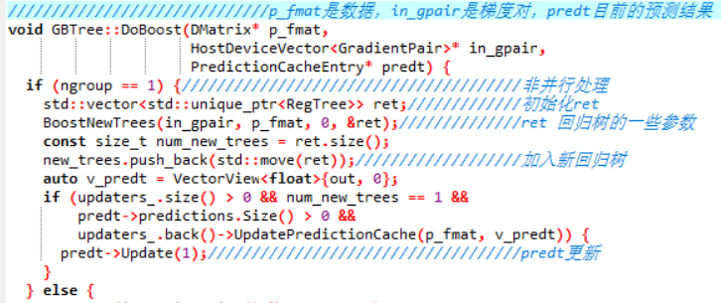

Doboost
DoBoost
in_gpair
最小化目标函数
梯度信息

Slide 3
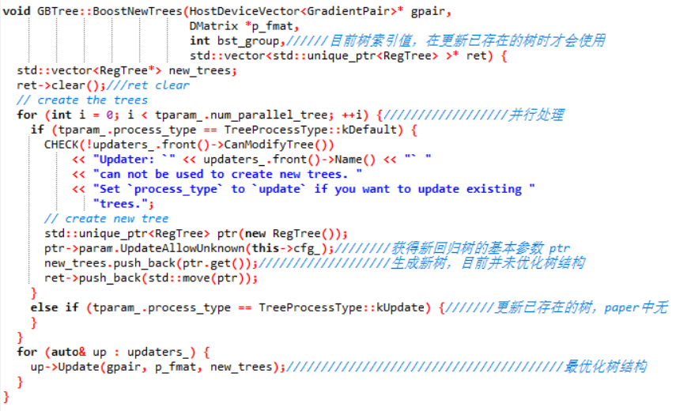
Doboost-BoostNewTree

Slide 4

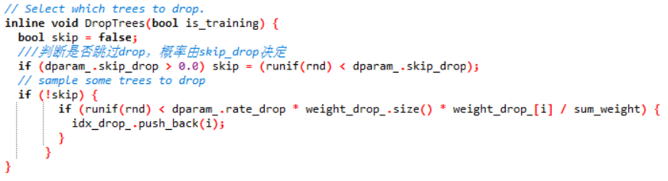
DARTBoost
Dropout:
Dropout whole tree
Binomial-plus-one technique
each of the existing trees in the ensemble is dropped with a probability .
if no tree was selected to be dropped, a single tree is selected uniformly at random to be dropped.

Slide 5
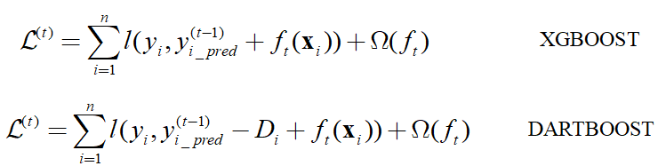
DARTBoost
Object function:
Normalization step：
the new trained tree T is trying to close the gap between now-predictor and the optimal predictor, however, the dropped trees are also trying to close the same gap.

Slide 6
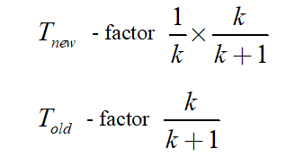
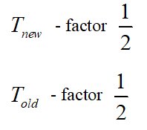
DARTBoost
Normalization step：
Tree: new trees have the same weight of each of dropped trees ( paper )
Forest: New trees have the same weight of sum of dropped trees

Slide 7
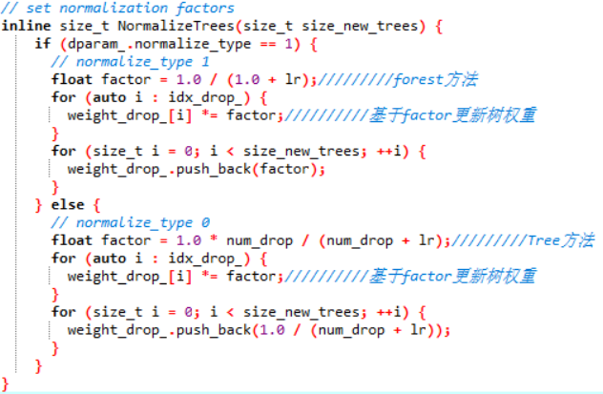
DARTBoost
Normalization step：

Slide 8
THANKS！

